Slide 1
Data-Driven Cloth for Interactive Applications
UE24CS352A MACHINE LEARNING · MINI-PROJECT 2026
Using a neural network to predict how clothes move with the body
Tejas Ponnappa · PES1UG24CS498 | Mukesh Sheregar · PES1UG25CS828
Notes:
Tejas. Say who you are and what the project is in one line: we reproduced a Stanford paper (Xue and Wu, 2021) that uses a neural network to predict how clothing moves from the body pose, using a public dataset called TailorNet. Then the order is: the problem, the paper, our data, our model, results, and a demo.

Slide 2
Clothes in games and VR try-on have to move with the body
THE PROBLEM
Online games and VR try-on need cloth that moves realistically when the body moves. There are three ways to get that.
Physics simulation
Skinning
Ours: a neural network
Very realistic, but it takes around 3 minutes to simulate one pose. Far too slow for a game.
The cloth just sticks to the body. Fast, but it looks stiff.
Simulate once, train on that data, then predict the cloth from the pose in milliseconds.
Our task: body pose in, cloth shape out
2 / 10
Notes:
Tejas. Explain the three ways in your own words. Physics simulation: realistic but about 180 seconds (3 minutes) per coat in the paper. Skinning: cloth sticks to the skeleton, instant but stiff. Ours: learn from simulated data, then predict. Likely question: what is the task exactly? Answer: pose goes in, the shape of the cloth comes out (details on the data slide).

Slide 3
Xue and Wu, Stanford CS229, 2021
THE PAPER
They made 10,000 poses of a coat. The poses and the skinned coat came from Blender, and the cloth was simulated in PhysBAM.
A network predicts, for every point on the coat, how far it is from the resting coat.
They tried linear regression, a network that outputs the offsets directly, and a network with PCA using 256, 128 or 64 numbers.
Best was the network with PCA 128. It was slightly better than direct and about 2.6 times better than linear regression.
3 / 10
Notes:
Tejas. The paper simulated 10,000 poses: Blender gave the poses and the skinned coat, PhysBAM simulated the cloth. The network predicts the offset of each coat point from the rest coat. Compared: linear regression (baseline), direct output, and PCA with 256, 128 and 64 numbers. Their best was PCA 128: test cost 1.50e-4, direct 1.59e-4, linear regression 3.83e-4, so about 2.6 times better than linear. The coat has 2,170 points, so 6,510 output numbers.

Slide 4
TailorNet, male short pants
THE DATA
The paper's coat data is not public, so we used TailorNet, a public set of simulated garments.
The cloth
The input
The poses
2,710 points, and each has x, y and z, so we predict 8,130 numbers. The paper had 2,170 points, so 6,510.
86 numbers: 72 for the body pose, 10 for the body shape and 4 for the clothing style.
3,833 in total. We removed 91 outliers with too large an offset (over 19.8 cm). Left: 2,245 to train, 748 to validate, 749 to test.
4 / 10
Notes:
Tejas. We used TailorNet because the paper data is private. Male short pants: 2,710 points times 3 coordinates is 8,130 outputs (the paper: 2,170 points, 6,510). Input is 86 numbers: SMPL pose 72, shape 10, style 4 (the paper used 56 for one coat). 40 combinations of body shape and style, up to 100 poses each, 3,833 poses. The target is the simulated cloth minus the rest cloth of that shape and style, in cm. Outliers: largest offset above median plus 5 robust standard deviations, 19.8 cm, 91 removed; we did not inspect them one by one. The split is random, so test poses share body shapes with training. PCA is fitted on the training set only.

Slide 5
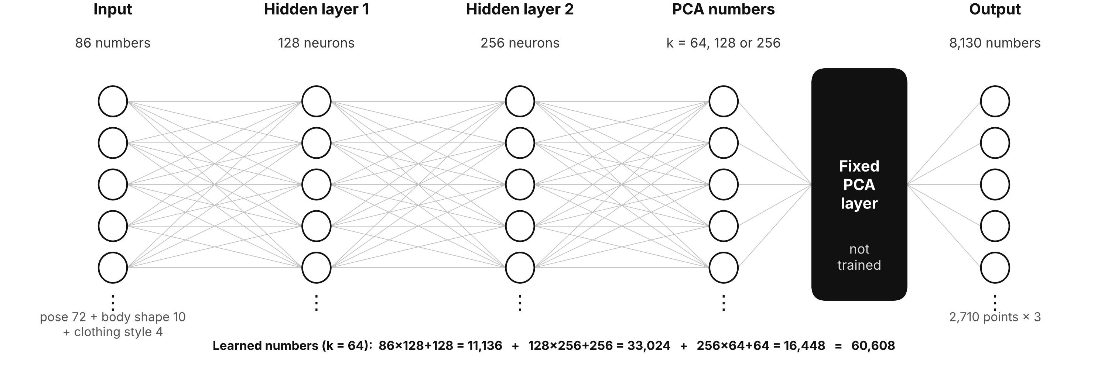
The network predicts a few PCA numbers, then expands them
OUR MODEL
Predicting all 8,130 numbers directly is heavy, so the network predicts k PCA numbers (64, 128 or 256) and a fixed PCA layer works out all 8,130 from them. We also tried skipping PCA, and a plain linear regression. Each network was trained for 200 and for 1,000 epochs.
5 / 10
Notes:
Mukesh. Walk the diagram left to right: 86 inputs, hidden layer of 128, hidden layer of 256 (ReLU), then k PCA numbers, then the fixed PCA layer that gives 8,130 outputs. The PCA layer is not trained; it is built from the training data. Parameters for k = 64: 60,608; k = 128: 77,056; k = 256: 109,952; direct: 2,133,570. Adam, learning rate 1e-4, batch size 32; we keep the epoch with the best validation error. One epoch is one pass through the training data. Linear regression is solved directly by least squares. Likely question: why PCA? Answer: the cloth points move together, so a few numbers describe the shape, and the network becomes much smaller.

Slide 6
What each file does
THE CODE
File | What it does
src/data_tailornet.py | Loads TailorNet, works out the cloth offsets, removes outliers and splits the data
src/data.py, src/utils.py | Outlier filter and small helpers (paths, folders)
src/pca.py | Fits PCA on the training offsets
src/model.py | The network with the fixed PCA layer, and the linear regression baseline
src/train.py | Trains a model and keeps the epoch with the best validation error
src/evaluate.py | Measures test error and speed, and draws the plots
demo.py | The live viewer: real cloth next to our prediction
run_all_tn.bat | Runs everything in one go (builds the data, trains all models, evaluates)
6 / 10
Notes:
Both. Tejas covers the data loading, training, evaluation, demo and the run script; Mukesh covers pca.py (fits PCA with an SVD on the training offsets and gives the top k components) and model.py (the network whose last step is a fixed linear layer built from those components, plus the closed-form linear regression). The README has the setup and the commands. run_all_tn.bat builds the dataset from the TailorNet download, trains all five models and writes the results table and plots.

Slide 7
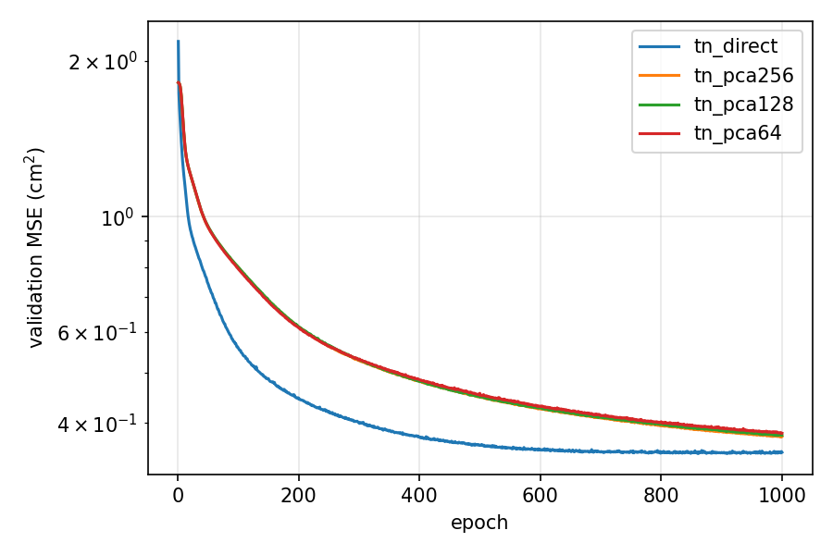
The networks make 55–58% less error than linear regression
RESULTS
Model | Size | Error, 200 ep | Error, 1000 ep | Point error (cm)
Linear regression | 707,310 | 0.907 | 0.907 | 1.207
Network, direct | 2,133,570 | 0.475 | 0.379 | 0.753
Network + PCA 256 | 109,952 | 0.662 | 0.403 | 0.788
Network + PCA 128 | 77,056 | 0.662 | 0.406 | 0.793
Network + PCA 64 | 60,608 | 0.660 | 0.410 | 0.799
Validation error over 1,000 epochs
The best network is about 2.4 times better than linear regression (the paper got 2.6). Point error is the average distance between where we put a cloth point and where the simulation puts it.
749 test poses, one run. Error = mean squared error (cm²).
7 / 10
Notes:
Tejas. Test set of 749 poses, one run. Error is mean squared error in cm squared; predicting the training average gives 1.868. Point error ("vertex error") is the mean distance in cm between the predicted and the true position of each cloth point. Networks 0.379 to 0.410 against 0.907 for linear regression: 55 to 58 percent lower, best 2.4 times better (paper 2.6). At 200 epochs the PCA networks were still at 0.66, so training length matters a lot for them. The k values differ by less than 2 percent, which is within single-run noise, so we do not claim a best k. Speed: 0.015 to 0.064 ms per pose when predicting 256 at a time; one pose at a time was 0.3 to 2.1 ms. A game frame has about 16 ms.

Slide 8
Same pattern against linear regression, but PCA is not better for us
PAPER VS OURS
Model | Paper: test cost | Paper: less error than linear | Ours: test error | Ours: less error than linear
Linear regression | 3.832e-4 | – | 0.907 | –
Network, direct | 1.592e-4 | 58% | 0.379 | 58%
Network + PCA 256 | 1.527e-4 | 60% | 0.403 | 56%
Network + PCA 128 | 1.498e-4 | 61% | 0.406 | 55%
Network + PCA 64 | 1.568e-4 | 59% | 0.410 | 55%
Both beat linear regression by a lot, and both trained with Adam, learning rate 1e-4, batch size 32 and 1,000 epochs.
In the paper PCA 128 was the best. For us direct was best, and the three PCA sizes are almost the same.
The two sets of numbers are on different scales (different data), so compare the "less error than linear" columns, not the raw values.
8 / 10
Notes:
Tejas. Left is Table 1 of the paper (test cost), right is ours (test MSE in cm squared). The raw numbers cannot be compared because the data and units differ, so we compare each model with its own linear regression. Paper: direct 58 percent less error than linear, PCA 256 60, PCA 128 61 (best, 2.6 times better), PCA 64 59. Ours: direct 58, PCA 256 56, PCA 128 55, PCA 64 55. The paper also says outputting more PCA numbers tended to overfit and fewer could not capture enough variance; our three sizes differ by under 2 percent, so we cannot say which is best. Both used Adam, learning rate 1e-4, batch size 32 and 1,000 epochs.

Slide 9
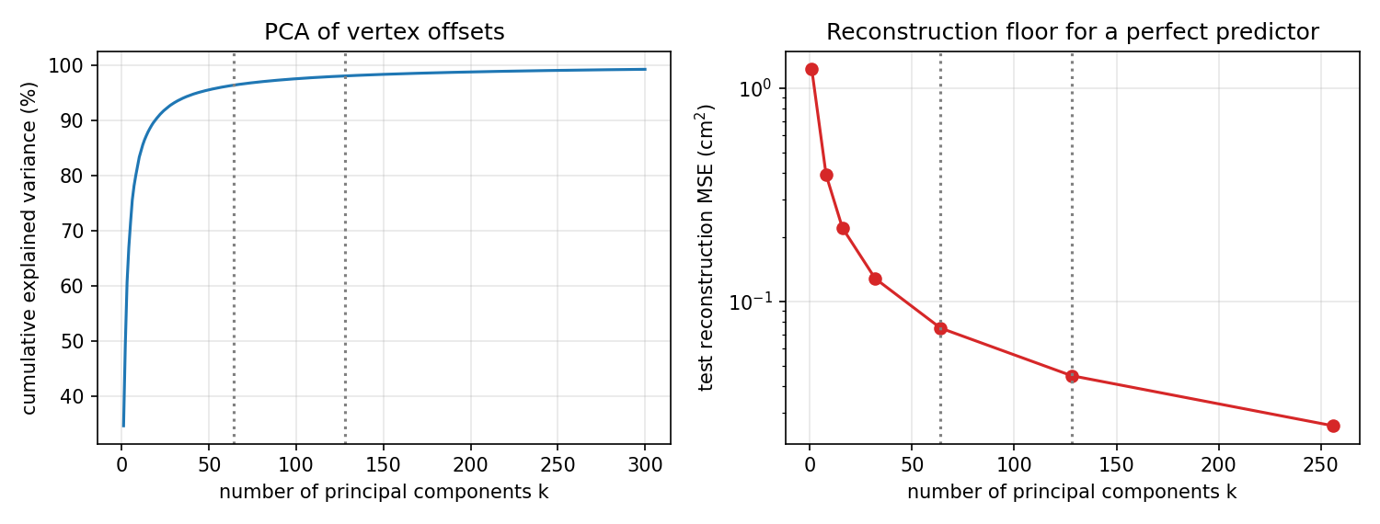
Direct has slightly less error, PCA is much smaller
PCA OR DIRECT?
Direct: error 0.379 but 2.13 million weights. PCA: error about 0.41 with only 60 to 110 thousand weights. That is 19 to 35 times smaller for 6 to 8% more error.
The paper found PCA slightly better than direct. We did not. The PCA networks were still improving at 1,000 epochs, so longer training might close the gap, but we did not test it.
9 / 10
Notes:
Mukesh. Left plot: how much of the cloth movement the first PCA numbers explain; it passes 95 percent at about 60 numbers. Right plot: the error a perfect predictor would still have with k numbers, about 0.075 at 64, 0.045 at 128 and 0.026 at 256 (read from the plot), far below our model error of about 0.4, so PCA is not what limits accuracy. Trade-off: direct 0.379 with 2.13 million parameters, PCA about 0.41 with 60.6 to 110 thousand. Be upfront that the paper found PCA better and we did not reproduce that. Likely question: why? Answer: we are not sure; the PCA networks were still improving while direct had levelled off, and the gap shrank from 39 percent at 200 epochs to 6 to 8 percent at 1,000.

Slide 10
What we found
CONCLUSIONS
The neural networks beat linear regression by a lot: 55 to 58% less error, and the best one is about 2.4 times better (the paper got 2.6).
PCA makes the network 19 to 35 times smaller for only 6 to 8% more error than direct.
The paper found PCA slightly better than direct. We did not see that: direct was best for us.
A prediction takes well under 2 milliseconds, far less than the 16 ms of a game frame.
10 / 10
Notes:
Tejas. Say the four findings in your own words. Networks beat linear regression: test MSE 0.379 to 0.410 against 0.907, best 2.4 times better (paper 2.6). PCA gives 19 to 35 times fewer parameters for 6 to 8 percent more error. The paper found PCA about 6 percent better than direct and 128 components best; we did not reproduce either, and the three k values are within 2 percent of each other, which is within single-run noise. Speed: 0.015 to 0.064 ms per pose in batches of 256, 0.3 to 2.1 ms one pose at a time. If asked about limits: one garment, one random seed, 3,742 poses against the paper 10,000, and a random split so test poses share body shapes with training; the PCA networks were still improving at 1,000 epochs, so longer training might close the gap (not tested). For the live demo run python demo.py --model tn_pca128 --compare tn_linreg --data data/tailornet.npz and keep the window open; arrow keys change the pose.

